Slide 1
Similarity of Downtown Toronto and Manhattan New York neigbourhoods
Capstone Project - Week 2 Assignment

Slide 2
The Problem
Lived in current neighbourhood for a long time, enjoy it!
Plan to move to another city
Not much information on the comparison of the cities/neighbourhoods
Haven’t been to the city before
Time to adapt
Many many concern...

Slide 3
Question
Can we find
neigbourhoods in Manhattan, New York
which are similar to Downtown Toronto?

Slide 4




Approach
Collect Data
Prepare Data/EDA
Modeling
Result & Recommendation
From various sources, Wiki, NYU, Foursquare API
Transforming, cleaning, concatenating and exploring several data sets
K-means clustering
We got the result!

Slide 5
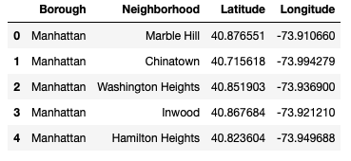
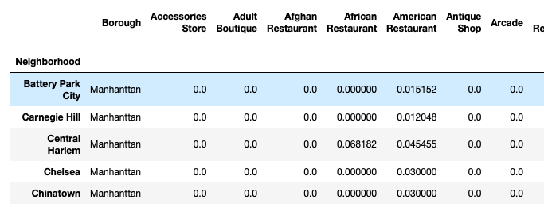
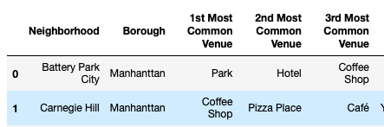
Data
borough/neighbourhood
geolocation
nearby venues
Mean of frequency
Common venues

Slide 6
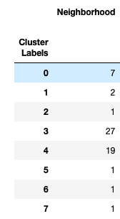
Result
K-means
Clustering

Slide 7
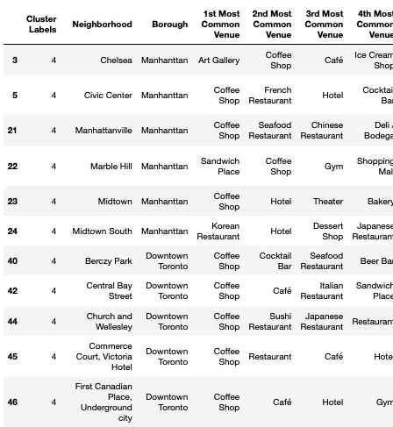
Discussion
cluster labels = 4
Neighbourhoods:
6 rows were Manhattan
13 rows in Downtown Toronto
Common venues:
Coffee shop
Cafe
Restaurants
...

Slide 8
Recommendation
group the categories into smaller number of category
check other features such as crime, air quality, transportation figures
Possible further studies: better places to live with environmental and nearby venues data, safety of neighbourhoods, relating sales figures to venues categories...

Slide 9
Q & A
Thank you!

